Slide 1

Pediatric PRN Role: Education strategies
Pediatric Pain PRN Curriculum
Notes:
Materials: Flip chart or whiteboard and Markers
Provide participant guide at least 1 week in advance.
Provide project planning guide
For reference: Participant Guide – pages 15, 16, 43-47, 65-74
Room setup in tables o f 4-6-8 depending on number of participants
Display slide as participants walk in
Allow 5 minutes for people to grab food if this is a meal session
(See course director guide regarding conducting sessions during meals).
This session is 30 minutes and includes an additional 30 minute activity (FAST FIX).
Welcome & Introductions: Introduce facilitator if necessary
© 2017 Manworren & Lurie Children’s Hospital
All rights reserved. Version 2019

Slide 2
What to Expect
Interactive Presentations
Case Studies
Pain Rounds
Working Lunches
Special Topics
Coaching & Networking
Breakout Sessions
Notes:
ASK: What educational strategies have you found effective in this course so far?
Select participants willing to share their answers to this question.
Write on flipchart or whiteboard
[Limit discussion to 5 minutes]
[10 minutes of 30 minute session is complete]
© 2017 Manworren & Lurie Children’s Hospital
All rights reserved. Version 2019

Slide 3

How does your team learn?
Consider your leaders, team members, and other healthcare professionals.
Notes:
READ: Introduce yourself to the participants at your table. Then with your table mates discuss your answers to the questions on the slide.
You will have 10 minutes to discuss and prepare to share your plan with the group
[Give groups 10 minutes to discuss questions]
Select participants willing to share group answers.
[LIMIT to 1-2 mins/group, max of 5]
Write changes to the plan on flipchart or whiteboard
[25 minutes of 30 minute session is complete]
© 2017 Manworren & Lurie Children’s Hospital
All rights reserved. Version 2019

Slide 4
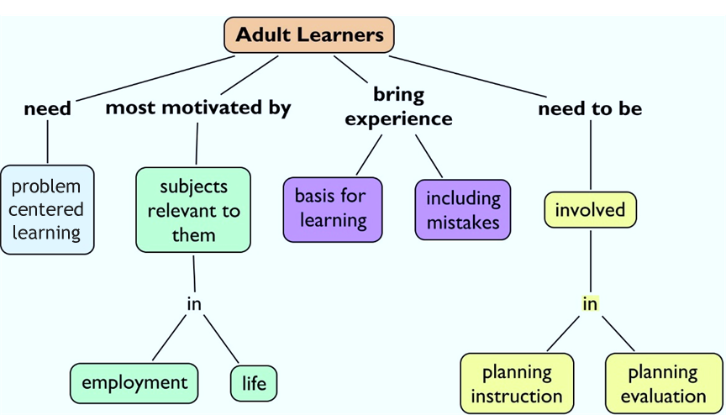
The PRN as a Teacher
Incorporate adult learning principles
Adults learn from their own experiences.
Notes:
READ:
PRNs are teachers and educators. To be successful, you’ll need to teach your team using methods by which they learn best. You identified ways in which principles of adult learning have been successful in helping your co-workers gain needed knowledge and skills. Educating adults is less about telling and more about building on their experiences.
First, provide a foundation or context for learning that’s based on what they need or want to know.
Adult learners are motivated by content that is relevant, builds their confidence, captures their attention, or provides satisfaction.
Adult learners want to be actively involved in learning rather than being lectured to.
© 2017 Manworren & Lurie Children’s Hospital
All rights reserved. Version 2019

Slide 5
The PRN as a Teacher
Use effective teaching strategies, formats, and resources
Source: National Training Laboratories. Bethel, Maine.
Notes:
READ: Discussion, practice, and teaching are the most engaging and effective strategies. That is why these strategies are used in this curriculum.
© 2017 Manworren & Lurie Children’s Hospital
All rights reserved. Version 2019

Slide 6

Fast Fact Check and Fix Instructions
Pick a place to meet with your team.
Share what you have learned (because you were at different activities, you may have learned different things).
Check your facts.
Then employ a creative adult learning strategy in the next 30 minutes to teach your unit this new pain management fact.
Plan to share evidence of what your group has learned when your table reconvenes.
Notes:
Fast Fact Check and Fix
READ:
You are now going to teach to reinforce your learning.
You will have 30 minutes to assemble your team, go to your unit and teach them something you learned in this course and return
[Give groups 30 minutes to complete FAST FIX]
Select participants willing to share group answers.
[LIMIT to 1-2 mins/group, max of 5]
[30 minutes of 60 minute session is complete]
© 2017 Manworren & Lurie Children’s Hospital
All rights reserved. Version 2019

